Slide 1
SPRING BOOT REST API
JPA, JDBC

Slide 2
JPA: What is JPA and why it is used?
Java Persistence API
A standard API for accessing databases
JPA is needed in order to interact with a relational database such as Oracle, DB2, SQL Server or MySQL.
JPA permits the developer to work directly with objects rather than with SQL statements.
JPA allows you to load and save Java objects and graphs without any DML language at all.

Slide 3
More about JPA
JPA is the standard way of persisting Java objects into relational databases.
It maps java classes onto relational tables
Hibernate is one of the JPA provider
JDBC is a low level standard for interaction with databases whereas JPA allows you to use an object model in your application which can make your life much easier.

Slide 4
Application to access MySQL Database: Using Spring Data JPA
Step 1: Install MySQL
Step 2: Create a database ‘mydb’
Step 3: Create a table ‘User’ with
id: int
name: varchar(50)
email: varchar(50)
Step 4: Create a Spring Application
Step 5: Create a Userrepository class to connect with database

Slide 5
Application to access MySQL Database: Using Spring Data JPA
Step 6: Create an Entity class to map with table
Step 7: Create a Controller class to access data
Step 8: In application.properties file, include dbname, username, password details
Step 9: Run mvn sping-boot:run
Step 10: Install Postman
Step 11: Send GET/POST method to access data

Slide 6
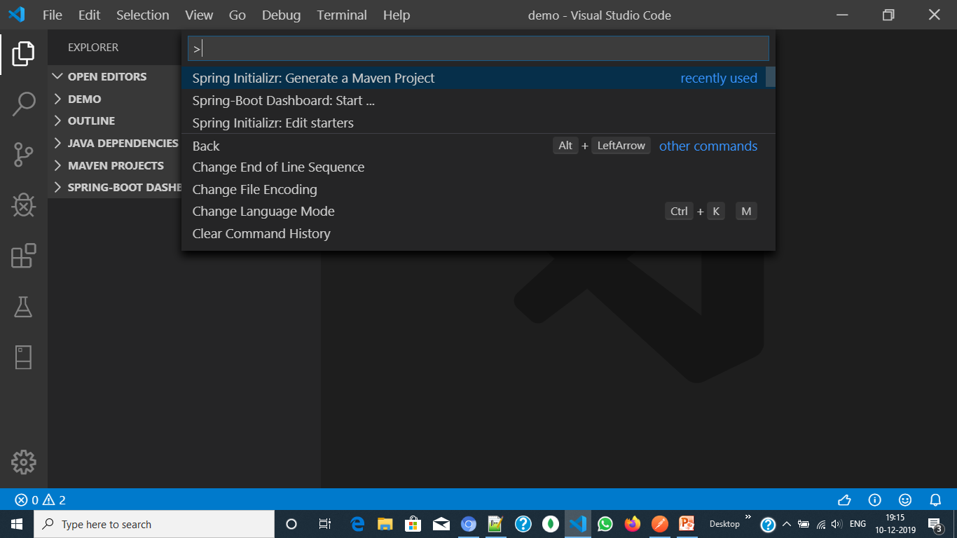

Slide 7
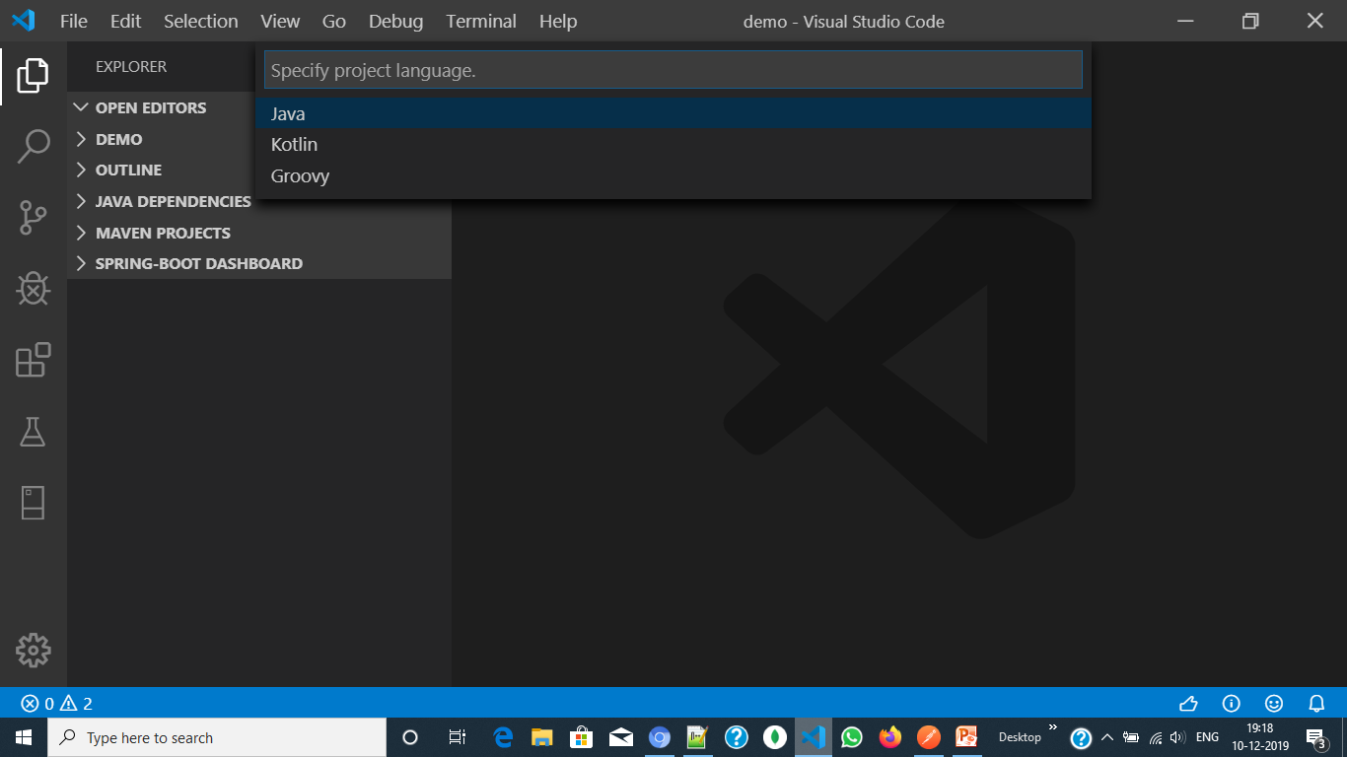

Slide 8
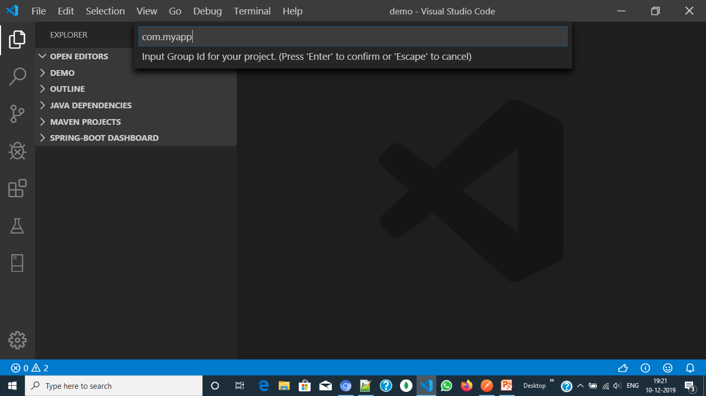

Slide 9
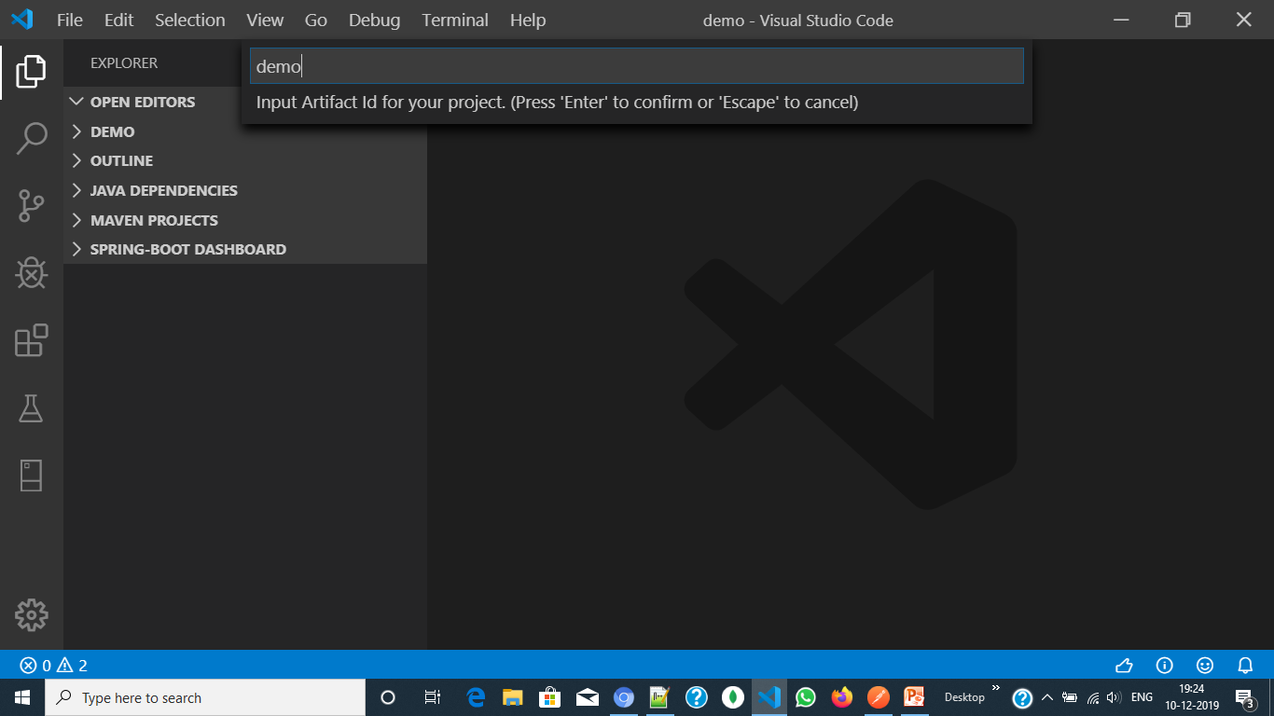

Slide 10
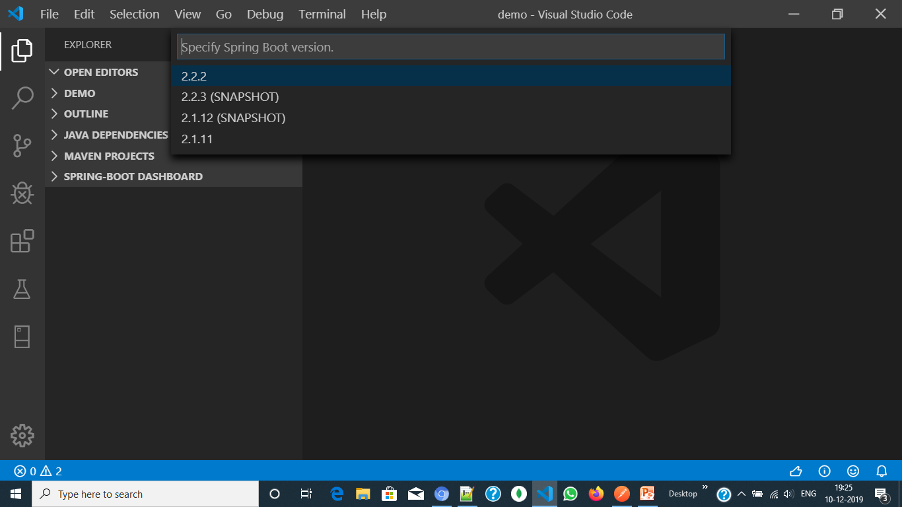

Slide 11
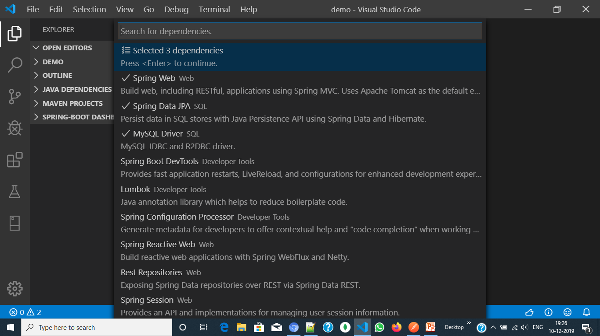

Slide 12
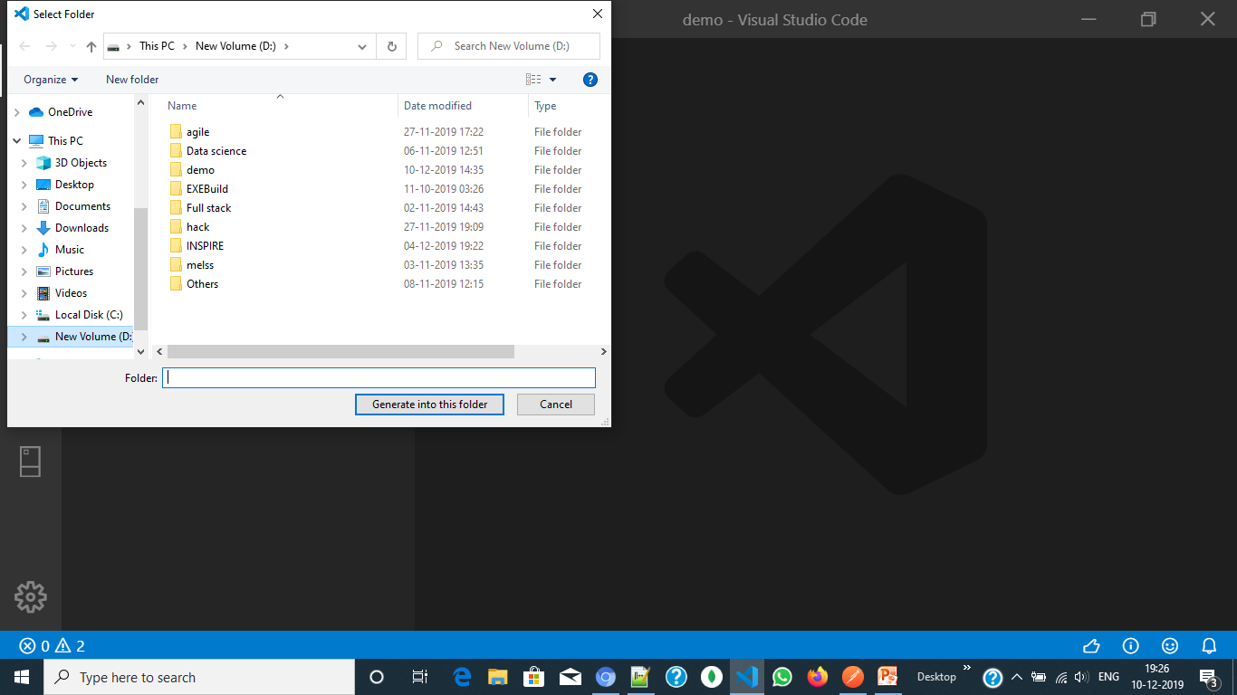

Slide 13
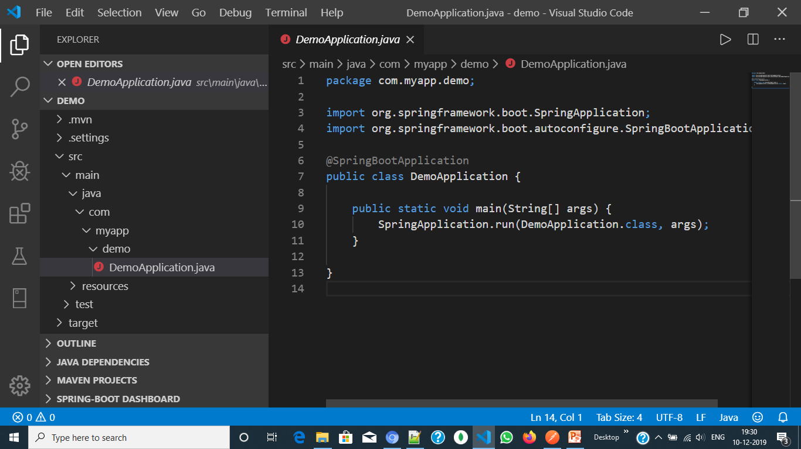

Slide 14
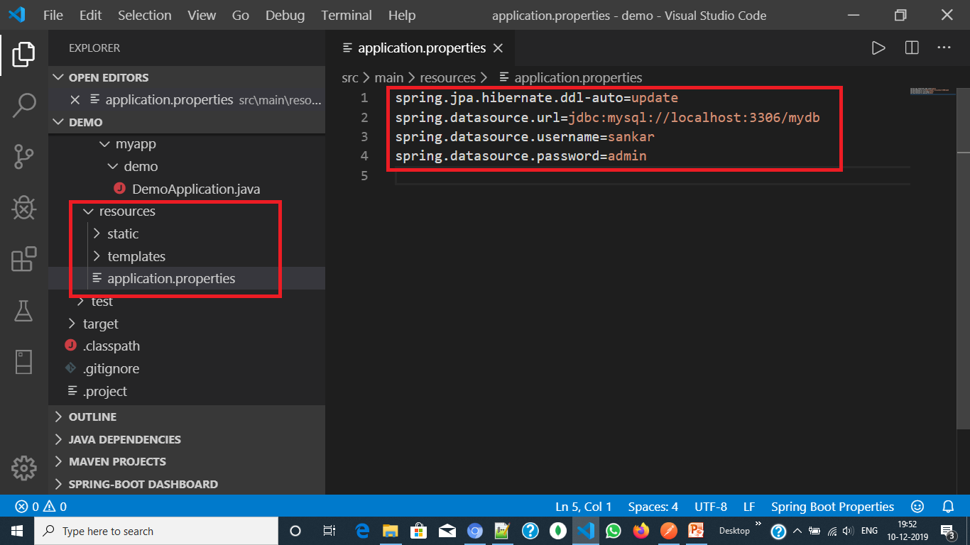

Slide 15

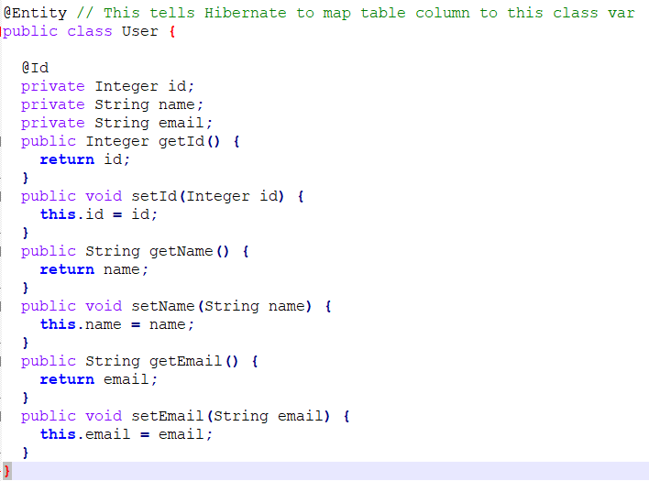
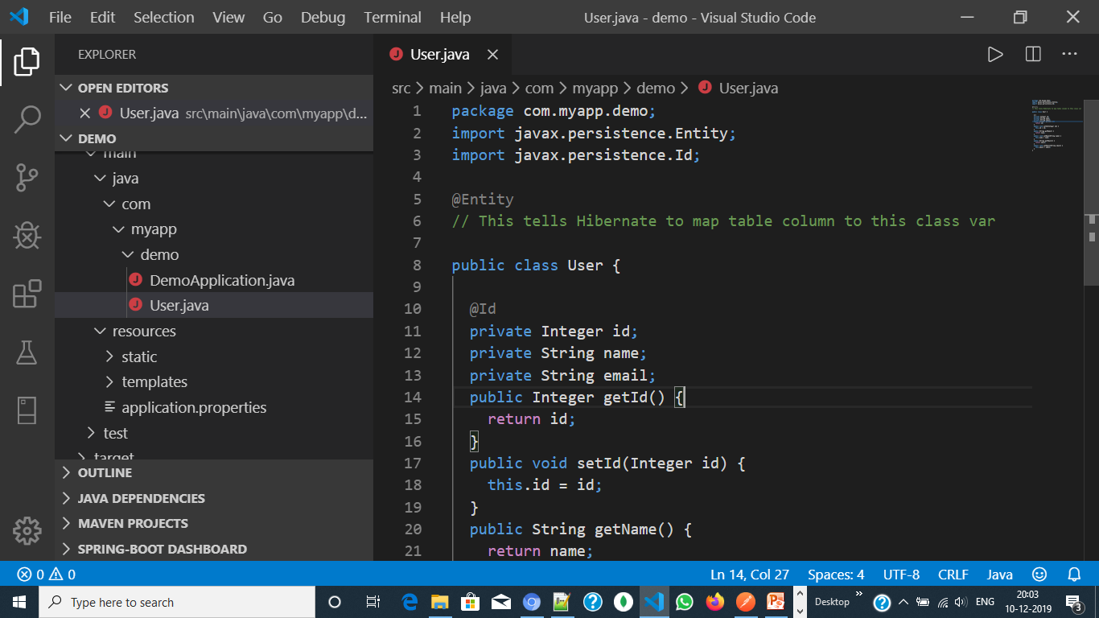

Slide 16
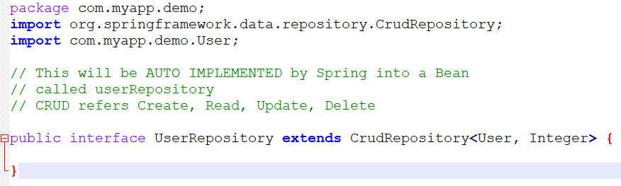
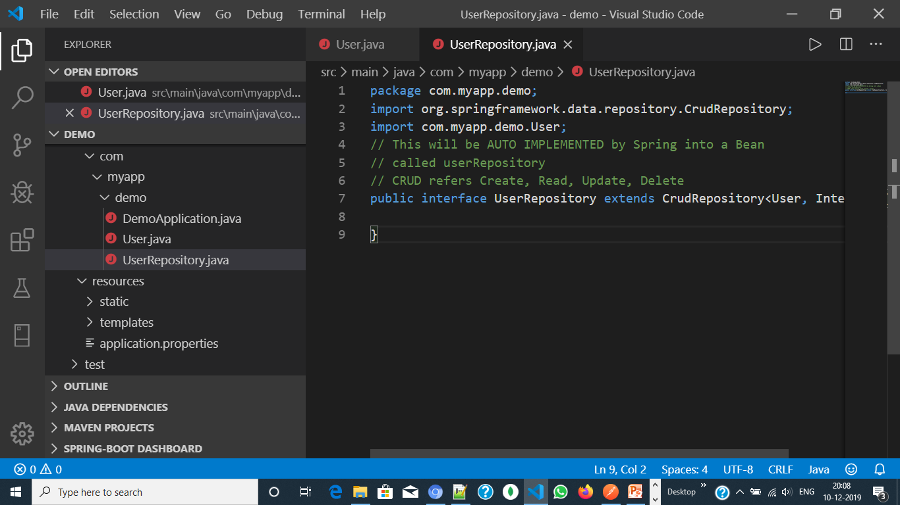

Slide 17
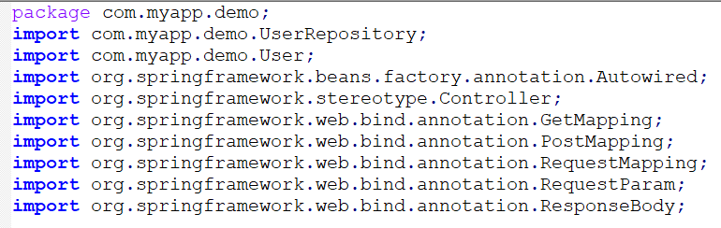
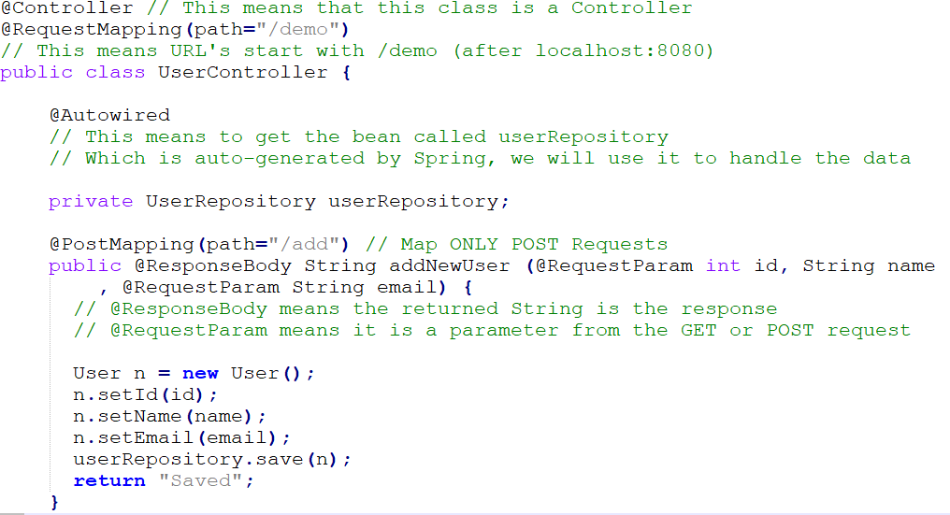
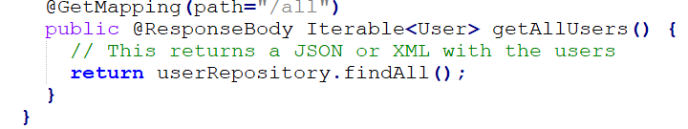

Slide 18
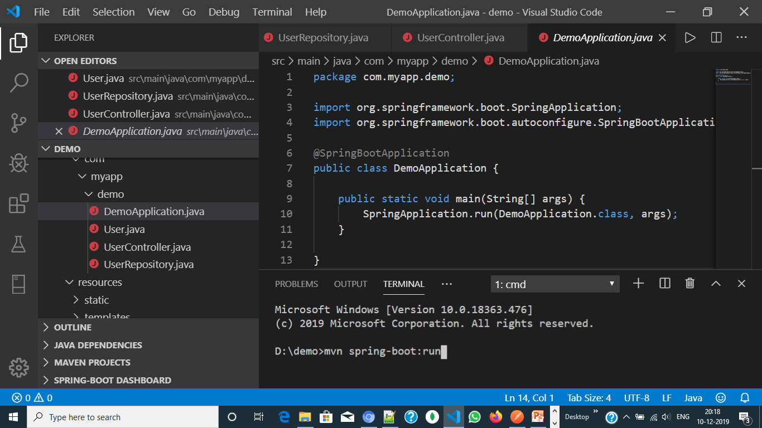

Slide 19
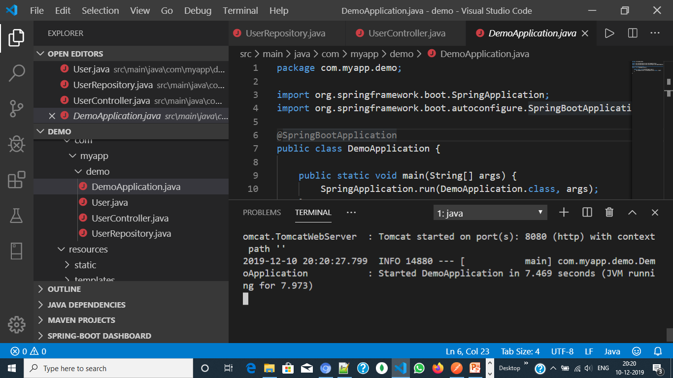

Slide 20
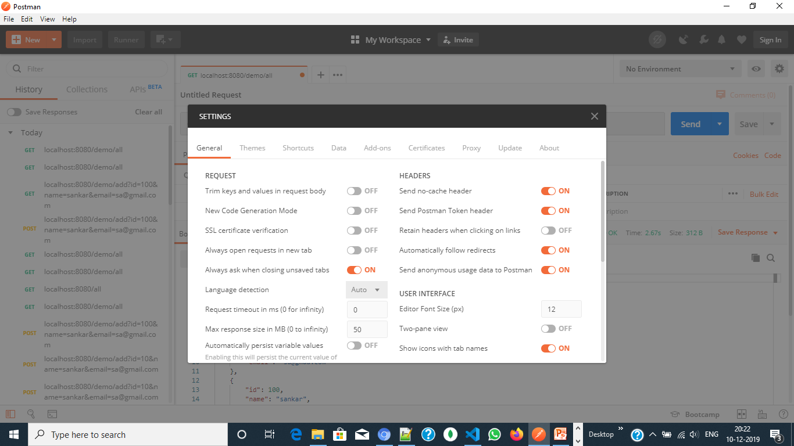

Slide 21
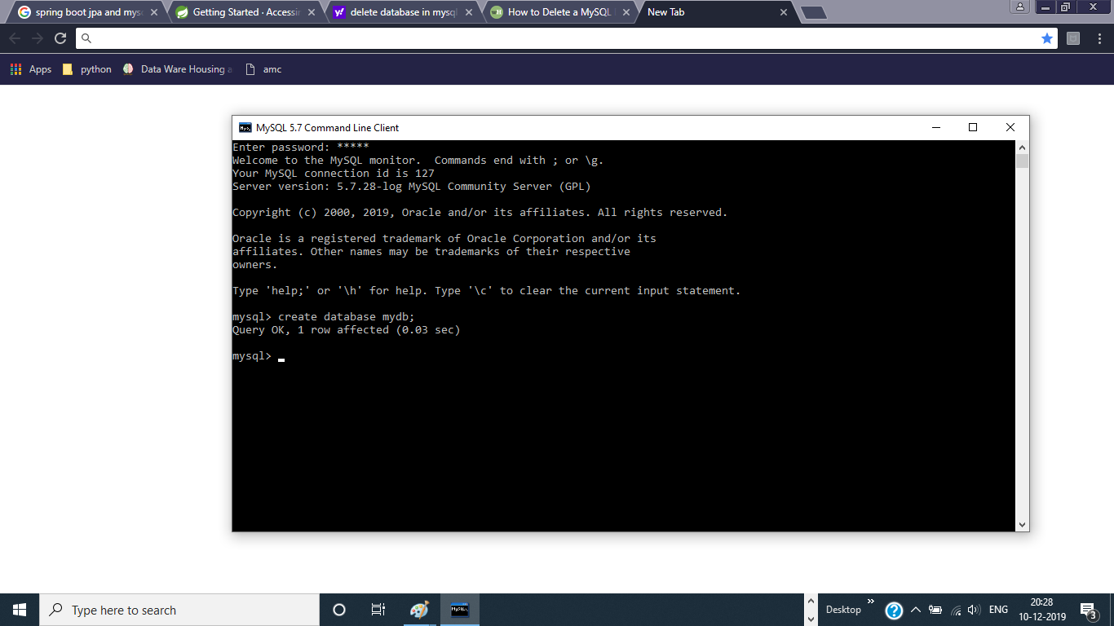

Slide 22
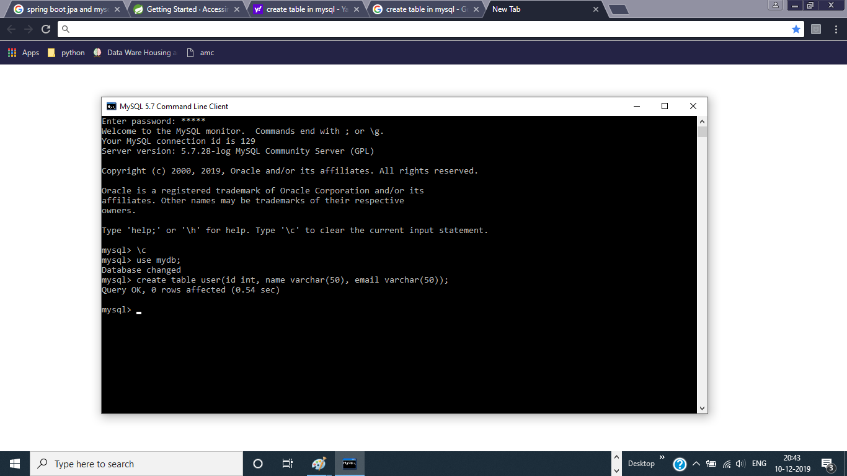

Slide 23
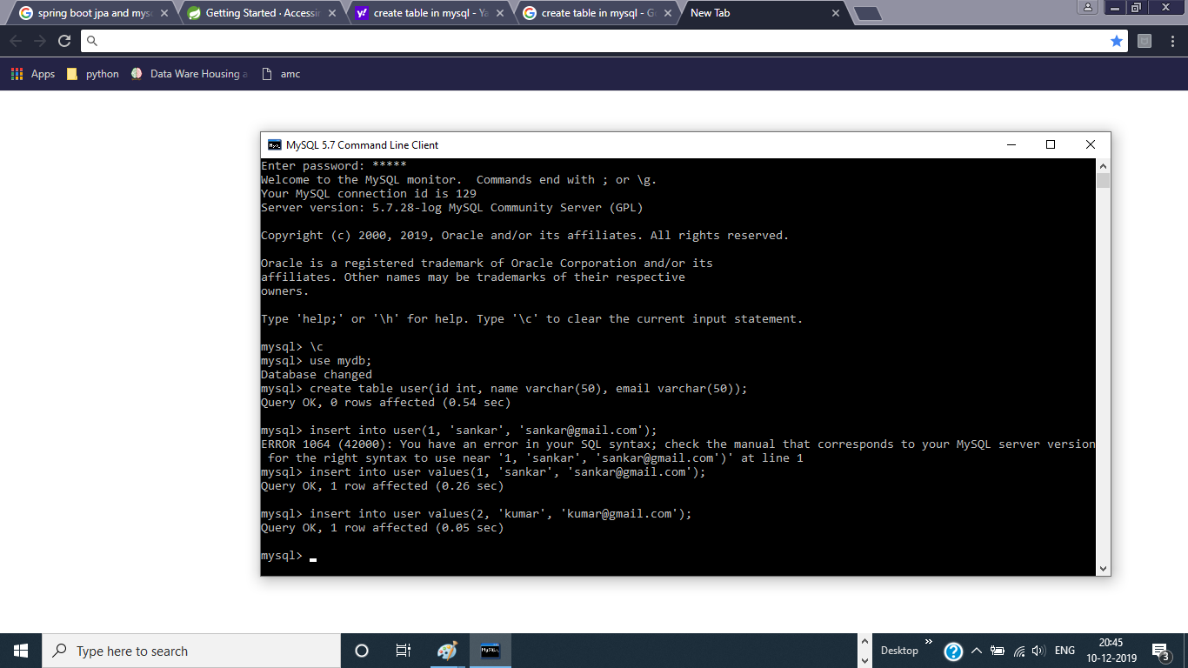

Slide 24
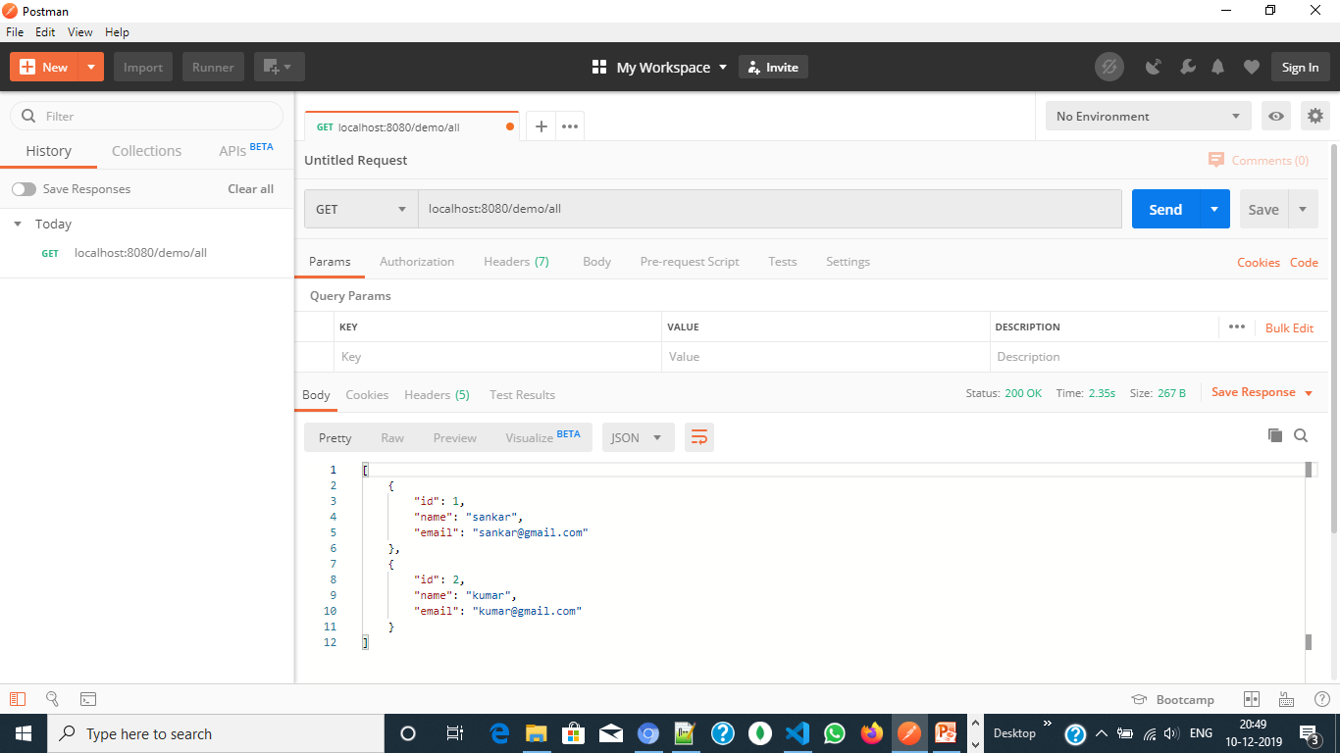

Slide 25
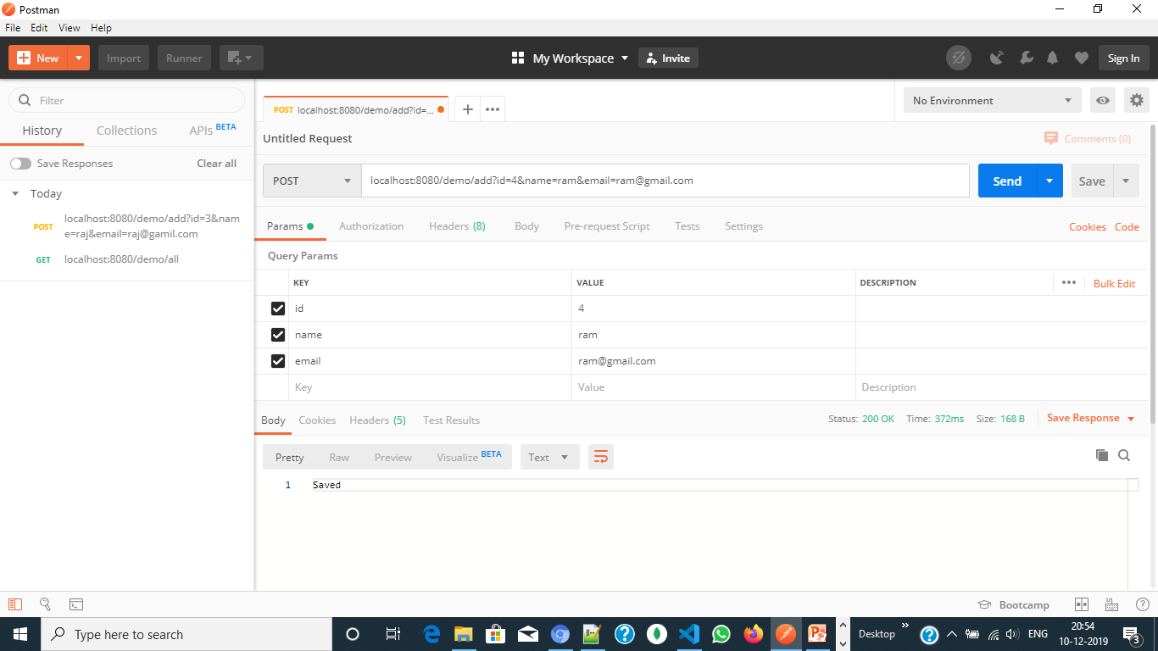

Slide 26
Spring Boot, MySQL, JPA, Hibernate Restful CRUD Application development
Create, Retrieve, Update, Delete

Slide 27
Step 1 : Create SpringInitializer: maven project
Step 2 : Enter the details as follows –
Group : com.example
Artifact : demo
Name : demo
Package Name : com.example.demo
Java Version : 1.8 (Default)
Spring 2.2.2
Dependencies : Spring Web, JPA, MySQL, DevTools

Slide 28
Step 3 : Create database ‘mydb’ and table ‘student’ with following schema
Id: int
name: varchar(50)
dept: varchar(50)
rollno: int
Step 4 : insert two records with following details
(1, ‘sankar’, ‘cse’, 121)
(2, ‘ravi’, ‘ece’, 122)
Step 5 : Open application.properties in the src/main/resources directory and add the following connection attributes:
# Hibernate ddl auto (create, create-drop, validate, update)
spring.jpa.hibernate.ddl-auto=update
spring.jpa.show-sql=true
# Spring DATASOURCE
spring.datasource.url=jdbc:mysql://localhost:3306/mydb
spring.datasource.username=sankar
spring.datasource.password=admin

Slide 29
Step 6 : Create a model/entity class called ‘Student’ with necessary getter and setter methods for:
id:Long
name:String
dept:String
rollno:Long
Step 6 : Create a repository in the name of ‘StudentRepository’
Step 7 : Create a controller in the name of ‘StudentController’

Slide 30
Step 6 : Create a model/entity called ‘Student.java’ with necessary getter and setter methods for:
id:Long
name:String
dept:String
rollno:Long
Step 6 : Create a repository in the name of ‘StudentRepository.java’
Step 7 : Create a controller in the name of ‘StudentController.java’
Step 8: Create an exception in the name of “StudentNotFoundException.java”
Step 9: Issue mvn spring-boot:run command in the terminal

Slide 31
Step 10 : Open Postman
Step 11: Send and Receive request and response respectively.

Slide 32
Create model/Entity: Student.java
package com.example.demo;
import javax.persistence.*;
@Entity
public class Student {
@Id
private Long id; private String name; private Long rollno;
private String dept;
public Long getId() {
return id;
}
public void setId(Long id) {
this.id = id;
}
public String getName() {
return name;
}
public void setName(String name) {
this.name = name;
}
public Long getRollno() {
return rollno;
}
public void setRollno(Long rollno) {
this.rollno = rollno;
}
public String getDept() {
return dept;
}
public void setDept(String dept) {
this.dept = dept;
}
}

Slide 33
Create repository: StudentController.java
package com.example.demo;
import com.example.demo.StudentRepository;
import com.example.demo.Student;
import org.springframework.beans.factory.annotation.Autowired;
import org.springframework.stereotype.Controller;
import org.springframework.web.bind.annotation.*;
@Controller
@RequestMapping(path="/demo")
public class StudentController {
@Autowired
private final StudentRepository studentRepository;
public StudentController(StudentRepository studentRepository) {
this.studentRepository = studentRepository;
}

Slide 34
Create repository: StudentController.java …
@GetMapping(path="/all")
public @ResponseBody Iterable<Student> getAllStudents() {
return studentRepository.findAll();
}
@PostMapping(path="/add")
public @ResponseBody String addNewStudent(@RequestParam Long id,
@RequestParam String name,
@RequestParam Long rollno,
@RequestParam String dept)
{
Student student = new Student();
student.setId(id);
student.setName(name);
student.setRollno(rollno);
student.setDept(dept);
studentRepository.save(student);
return "Saved";
}

Slide 35
Create repository: StudentController.java …
@PutMapping(path="/update")
public @ResponseBody String updateStudent(@RequestParam Long id,
@RequestParam String name,
@RequestParam Long rollno,
@RequestParam String dept)
{
Student studentToUpdate = studentRepository.findById(id).orElseThrow(StudentNotFoundException::new);
studentToUpdate.setName(name);
studentToUpdate.setDept(dept);
studentToUpdate.setRollno(rollno);
studentRepository.save(studentToUpdate);
return "Updated";
}
@DeleteMapping(path="/delete")
public @ResponseBody String deleteStudent(@RequestParam Long id) {
studentRepository.deleteById(id).orElseThrow(StudentNotFoundException::new);
return "Deleted";
}
}

Slide 36
Create repository: StudentRepository.java
package com.example.demo;
import org.springframework.data.repository.CrudRepository;
import com.example.demo.Student;
public interface StudentRepository extends CrudRepository<Student, Long> {
}

Slide 37
Create exception: StudentNotFoundException.java
package com.example.demo;
import org.springframework.http.HttpStatus;
import org.springframework.web.bind.annotation.ResponseStatus;
@ResponseStatus(HttpStatus.NOT_FOUND)
public class StudentNotFoundException extends RuntimeException {
private static final long serialVersionUID = 1L;
public StudentNotFoundException() {
super("Student does not exist");
}
}

Slide 38
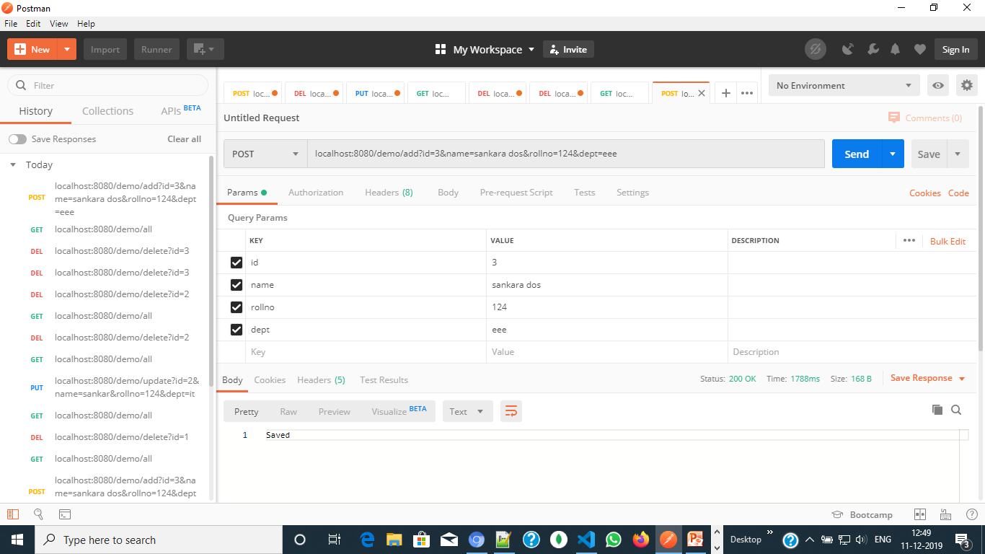

Slide 39
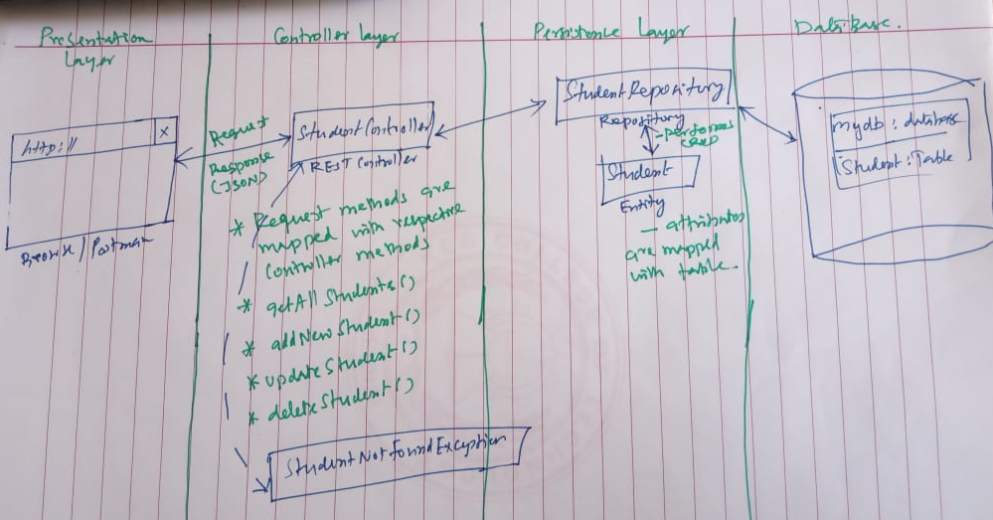

Slide 40
Spring Boot REST API
JDBC

Slide 41
Spring Boot JDBC
Spring Boot also provides starter and libraries for connecting to our application with JDBC
Step 1: Create Spring boot maven starter project
Step 2: Enter the details as follows –
Group : com.example
Artifact : demo
Name : demo
Package Name : com.example.demo
Java Version : 1.8 (Default)
Spring 2.2.2
Dependencies : Spring Web, Jdbc API, MySQL

Slide 42
Step 3: Add following code in application.properties:
spring.datasource.url=jdbc:mysql://localhost:3306/mydb
spring.datasource.username=sankar
spring.datasource.password=admin
spring.jpa.hibernate.ddl-auto=create-drop
Step 4: Create database ‘mydb’ and table ‘student’ with
id: int
name: varchar(50)
rollno: int
dept: varchar(50)
Step 5: Create a model called “Student.java” with getter and setter methods
Step 6: Create a controller called “StudentController.java”
Step 7: Run the application
Step 8: Open Postman
Step 9: Send a request

Slide 43
Student.java
package com.example.demo;
public class Student {
private int id;
private String name;
private int rollno;
private String dept;
public int getId() {
return id; }
public void setId(int id) {
this.id = id; }
public String getName() {
return name; }
public void setName(String name) {
this.name = name; }
public int getRollno() {
return rollno; }
public void setRollno(int rollno) {
this.rollno = rollno; }
public String getDept() {
return dept; }
public void setDept(String dept) {
this.dept = dept; }
}

Slide 44
StudentController.java
package com.example.demo;
import com.example.demo.Student;
import org.springframework.web.bind.annotation.*;
import org.springframework.beans.factory.annotation.Autowired;
import org.springframework.jdbc.core.JdbcTemplate;
import org.springframework.jdbc.core.BeanPropertyRowMapper;
import java.util.List;

Slide 45
StudentController.java …
@RestController
@RequestMapping(path="/demo")
public class StudentController {
@Autowired
JdbcTemplate jdbc;
@PostMapping(path="/insert")
public @ResponseBody String addNewStudent(@RequestParam Long id,
@RequestParam String name,
@RequestParam Long rollno,
@RequestParam String dept)
{
String query = "insert into student(id,name,dept, rollno)values("+id+",'"+name+"','"+dept+"',"+rollno+")“;
jdbc.execute(query);
return"data inserted Successfully";
}

Slide 46
StudentController.java …
@PutMapping(path="/update")
public @ResponseBody int updateStudent(@RequestParam int id,
@RequestParam String name,
@RequestParam int rollno,
@RequestParam String dept)
{
String query="update student set rollno="+rollno+", name='"+name+"', dept='"+dept+"' where id="+id;
return jdbc.update(query);
}
@DeleteMapping(path="/delete")
public @ResponseBody int deleteStudent(@RequestParam int id)
{
String query="delete from student where id="+id;
return jdbc.update(query);
}

Slide 47
StudentController.java …
@GetMapping(path="/find")
public @ResponseBody List<Student> findAll() {
String query = "SELECT * FROM student";
List<Student> students = jdbc.query(
query,
new BeanPropertyRowMapper(Student.class));
return students;
}
}

Slide 48
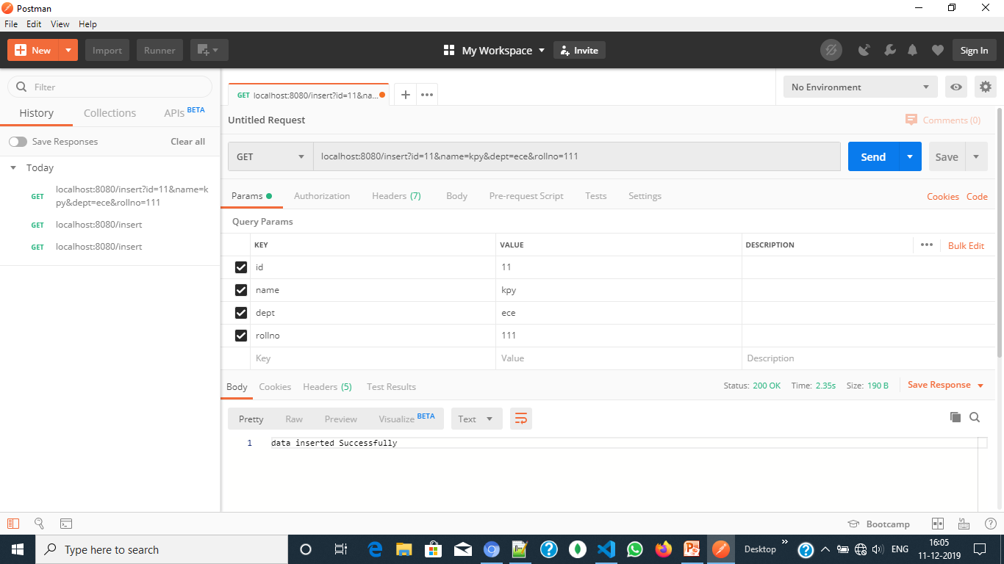

Slide 49
